Slide 1
EluNet Performance
7-28
Bishal

Slide 2
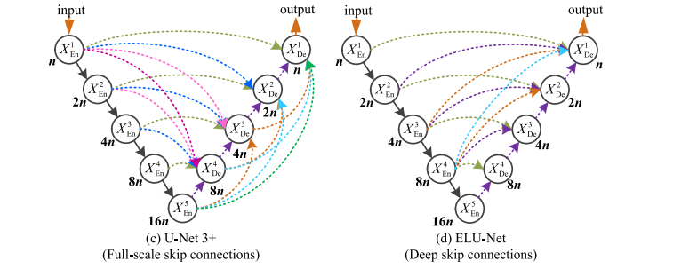
Model Architecture

Slide 3
Model Parameters
One of the reasons for higher parameters might be because of more connections in the deeper layers of the model which include same- and large-scale skip connections from the encoder to fully extract the features of the encoder.
Unet3+
EluNet
Total params: 1,691,427
Trainable params: 1,691,427
Non-trainable params: 0
Total mult-adds (G):121.93
Input size (MB): 2.44
Forward/backward pass size (MB): 2695.31
Params size (MB): 6.45
Estimated Total Size (MB): 2704.21
Total params: 3,194,499
Trainable params: 3,194,499
Non-trainable params: 0
Total mult-adds (G): 178.14
Input size (MB): 2.44
Forward/backward pass size (MB): 3100.59
Params size (MB): 12.19
Estimated Total Size (MB): 3115.21
Link
Model Summaries
Link

Slide 4
Results
EluNet is too expensive to run,
EluNet -> Per epoch, with batchsize – 8, kernel – 3, and channelsize – 16 ------- 47GB (GPU), 3.4 hour per epoch
Unet3+ -> Per epoch, with batchsize – 8, kernel – 3, and channelsize – 16 ------- 26GB (GPU), 29 mins per epoch
 | X3000 | X5000 | A type | D3 type | H2 type
UNet3+ | 0.7809 | 0.8895 | 0.7293 | 0.7692 | 0.7471
EluNet | 0.7605 | 0.7932 | 0.6490 | 0.7272 | 0.6949
50 Epochs
10 Epochs
Dice Scores
 | X3000 | X5000 | A type | D3 type | H2 type
UNet3+ | 0.7809 | 0.8895 | 0.7293 | 0.7692 | 0.7471
EluNet | 0.7823 | 0.8574 | 0.7470 | 0.7340 | 0.7132
50 Epochs
50 Epochs
Dice Scores

Slide 5
Final Results
 | X3000 | X5000 | A type | D3 type | H2 type
UNet3+ | 0.7809 | 0.8895 | 0.7293 | 0.7692 | 0.7471
EluNet | 0.7823 | 0.8574 | 0.7470 | 0.7340 | 0.7132
50 Epochs
50 Epochs
Dice Scores

